Slide 1

LABORATORY OF ADVANCED PROGRAMMING – MARCH 2026
Welcome to Mars. Please Don’t Die.
Presented by:
Alessandro Arellano Altuna
Lorenzo Bertucci
Aldo Bosco
Tiziano Coluzzi

Slide 2
Project Goal
The goal of this project is to develop an event-driven IoT automation platform for a simulated Mars habitat.
Heterogeneous Ingestion
Internal Normalization
Event-Driven Logic
Real-Time Automation
Persistent Storage
Collect data from REST devices via polling and from telemetry topics via asynchronous streams.
Convert diverse sensor payloads into a unified internal event format for system-wide compatibility.
Utilize a message broker to decouple data sources from automation processing and the dashboard.
Dynamically evaluate IF-THEN rules to trigger actuator updates instantly upon event arrival.
Ensure automation rules survive service restarts while maintaining a real-time sensor state cache.

Slide 3
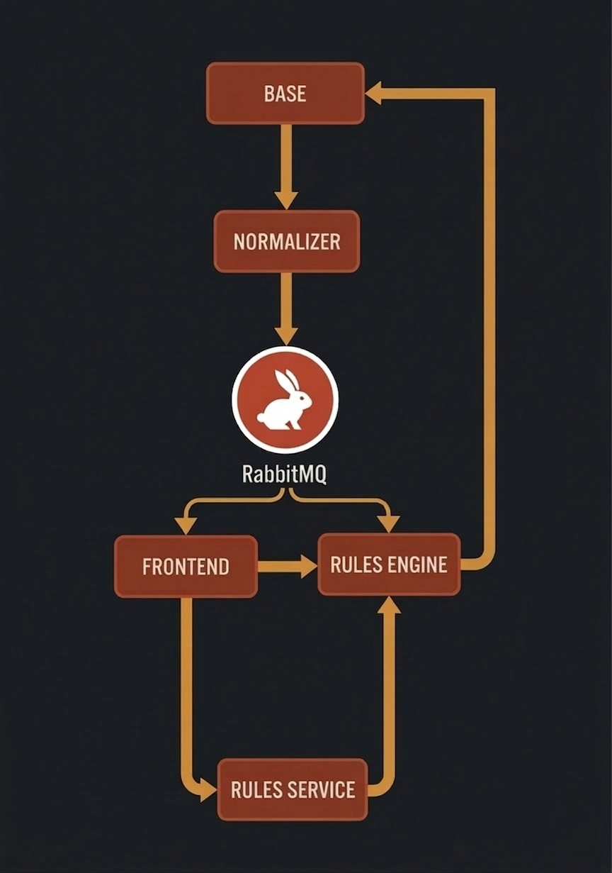
Event-Driven ARCHITECTURE
A distributed microservice architecture designed for scalability and fault tolerance
Main components:
Normalizer service
RabbitMQ message broker
Rule Engine
Rules Service + PostgreSQL
Frontend dashboard

Slide 4
Normalizer Service
Hybrid Ingestion
Responsible for collecting and standardizing data from Mars habitat heterogeneous sources.
The service polls REST sensors every 10 seconds and listens to asynchronous WebSocket telemetry streams.
Data Normalization
Converts raw, incompatible payloads into a unified CommonTelemetry schema using Pydantic models.
Event Publication
Standardized events are published as persistent messages to RabbitMQ, decoupling ingestion from logic.

Slide 5
Rule Engine
Logic Evaluation
The system's primary consumer, evaluating automation logic in
real-time.
Evaluates dynamic "IF-THEN" conditions (e.g., Temperature > 28°C) as soon as events arrive from the broker
Actuator Control
Triggers automated state updates by issuing REST commands to habitat hardware like fans and heaters.
Control Modes
Implements a state manager supporting AUTO, ON, and OFF modes for manual operator overrides.

Slide 6
RULES SERVICE
PostgreSQL Storage
A dedicated persistence layer ensuring automation rules survive system restarts.
Chosen for ACID compliance and reliable handling of concurrent requests from multiple microservices
RESTful Management
Provides full CRUD (Create, Read, Update, Delete) endpoints for dynamic rule configuration.
State Separation
Maintains persistent rules in the database while keeping live sensor states in-memory for maximum speed.

Slide 7
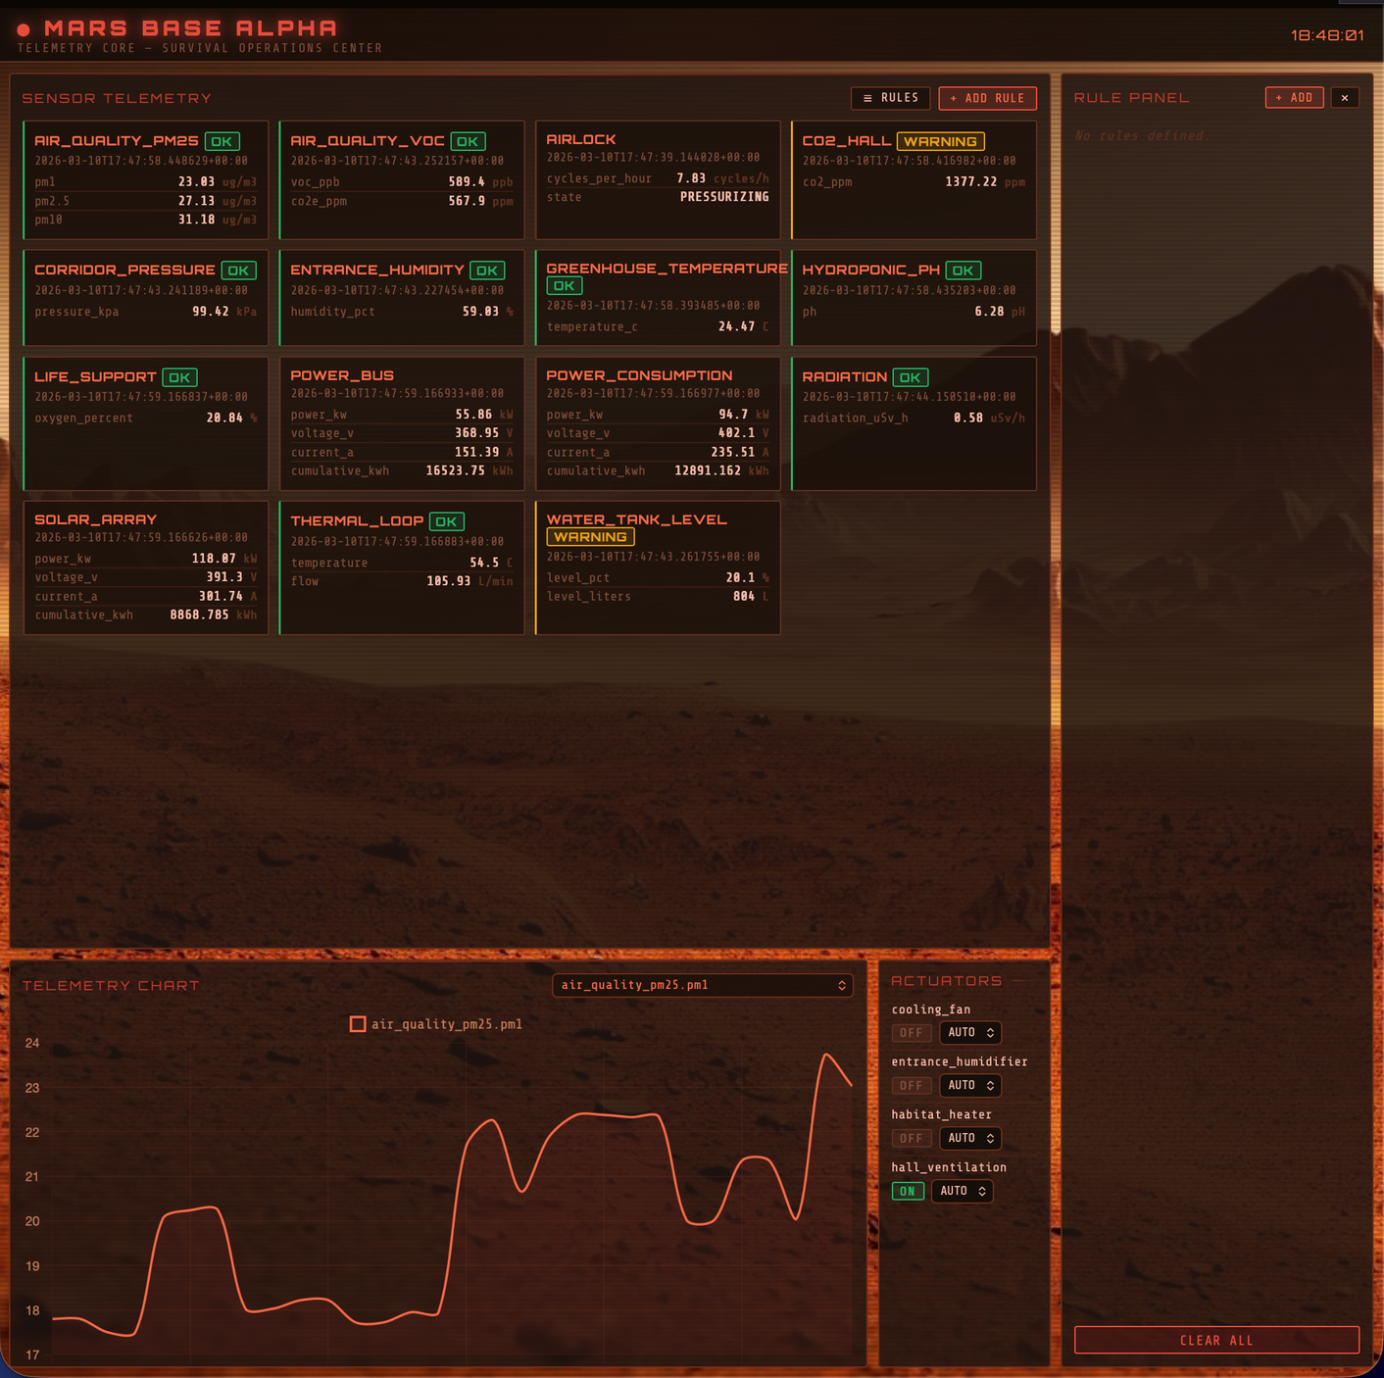
FRONTEND DASHBOARD
A real-time interface for habitat monitoring and mission-critical control
Real-time Telemetry
Displays live sensor readings and historical trends updated via persistent RabbitMQ consumers
Rule Management UI
Provides a user-friendly interface to manage 20 user stories, from life support to power safety.
Analytics & Rule Management
Combines live charts for trend monitoring with a dedicated panel for real-time CRUD operations on automation rules

